Slide 1




Module – 1: Artificial Intelligence & Big Data Analytics: An Introduction
Artificial Intelligence (AI) and Big Data Analytics have become integral parts of our modern world, transforming industries, enhancing decision-making, and revolutionizing the way we live and work. This introductory module will provide a comprehensive overview of the fundamental use cases, types of AI systems, and the diverse roles available in this exciting field.
by Ramanuj Saket

Slide 2

Artificial Intelligence: Unraveling the Future
1
What is AI?
2
AI in Action
3
The Power of AI
Artificial Intelligence (AI) refers to the development of computer systems capable of performing tasks that traditionally required human intelligence, such as visual perception, speech recognition, decision-making, and language translation.
AI is already being used in a wide range of applications, from personalized recommendations on e-commerce platforms to self-driving cars, medical diagnostics, and virtual assistants like Siri and Alexa.
AI systems can analyze vast amounts of data, identify patterns, and make predictions with incredible speed and accuracy. This allows for more informed decision-making, improved efficiency, and the ability to tackle complex problems in ways that were previously impossible.

Slide 3
The Data Revolution: Unlocking Insights
What is Data?
Structured, Unstructured and Semi-structured Data
Data Processing
Data refers to the raw information that is collected and stored, often in digital formats. It can take many forms, including text, numbers, images, audio, and video.
Data processing involves collecting, organizing, and analyzing data to extract meaningful insights. This can include tasks like data cleaning, transformation, and integration.
Structured Data: Organized and easily searchable, often stored in databases or spreadsheets with defined formats like rows and columns. Unstructured Data: Lacks a predefined format or structure, including text-heavy information such as emails, social media posts, and multimedia files. Semi-structured Data: Contains elements of both structured and unstructured data, often with tags or metadata that provide some organizational context, like JSON or XML files.

Slide 4

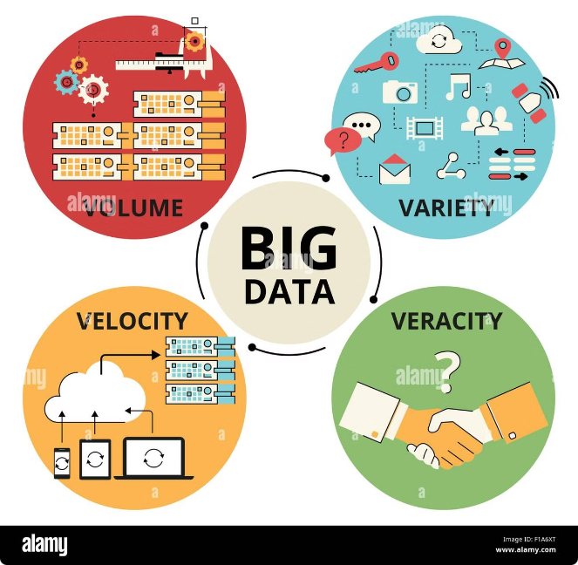
Big Data: The Data Explosion
What is Big Data?
Big Data refers to the massive and rapidly growing volume, variety, and velocity of data that is being generated worldwide. It is characterized by the “4 Vs" - Volume, Variety, Veracity and Velocity.
Volume
The sheer amount of data being created every day is staggering, with estimates suggesting that the global data sphere will grow from 33 zettabytes in 2018 to 175 zettabytes by 2025.
Variety
Big Data encompasses a wide range of data types, including structured, unstructured, and semi-structured data, from sources like social media, IoT devices, and enterprise systems.
Velocity
The speed at which data is being generated and the need for real-time analysis and decision-making is a defining characteristic of Big Data, driven by the proliferation of connected devices and online activities.
Link: Worldometer - real time world statistics (worldometers.info)
Veracity
Refers to the accuracy and trustworthiness of the data. It addresses issues related to data quality, reliability, and the potential for inconsistencies or errors.

Slide 5

Big Data Analytics: Unlocking Insights
Data Collection
1
The first step in Big Data Analytics is to gather data from various sources, including internal business systems, external data providers, and online platforms.
2
Data Preparation
The collected data must then be cleaned, normalized, and organized into a format that can be effectively analyzed, often involving tasks like data cleaning, transformation, and integration.
Data Analysis
3
Advanced analytical techniques, such as machine learning, predictive modeling, and data mining, are applied to the prepared data to uncover patterns, trends, and insights that can inform decision-making.

Slide 6

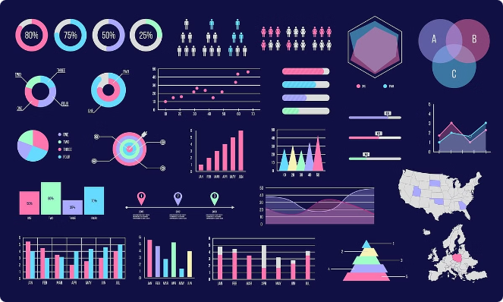
Relevance of AI and Big Data Analytics
1
Improved Decision-Making
AI and Big Data Analytics empower organizations to make more informed, data-driven decisions, leading to enhanced efficiency, cost savings, and competitive advantages.
2
Personalized Experiences
By leveraging AI and Big Data, businesses can offer highly personalized products, services, and customer experiences, meeting the evolving needs of their target audiences.
3
Advancements in Research
AI and Big Data Analytics have revolutionized fields like healthcare, scientific research, and environmental conservation, enabling breakthroughs and accelerating discoveries.
4
Increased Automation
AI-powered automation can streamline repetitive tasks, improve productivity, and free up human resources to focus on more strategic initiatives.

Slide 7


Case Study: Personalized Recommendations
Challenge
An e-commerce company wanted to improve the customer experience and increase sales by providing personalized product recommendations.
Solution
The company leveraged Big Data Analytics and machine learning algorithms to analyze customer browsing and purchase data, identifying patterns and preferences to generate tailored product recommendations.
Results
The personalized recommendations led to a significant increase in customer engagement, with higher click-through rates and conversion rates, ultimately driving a substantial boost in revenue for the company.

Slide 8
Use Cases of AI and Big Data Analytics
Healthcare
Finance
Retail
AI and Big Data Analytics are transforming the healthcare industry by enabling personalized medicine, early disease detection, and optimized treatment plans.
In the financial sector, AI and Big Data Analytics are used for fraud detection, portfolio optimization, and personalized investment recommendations.
Retailers leverage AI and Big Data to improve inventory management, personalize customer experiences, and optimize pricing and marketing strategies.
Example: Predictive analytics in cancer diagnosis and treatment planning.
Example: Automated stock trading algorithms based on market data analysis.
Example: Automated product recommendations based on customer purchase history and browsing behavior.
Some video links for use cases in Education, Robotics, and Music: 1. iHub Anthem (youtube.com), 2. Infinite Story Teller (youtube.com), 3. Page Whisperer: Specific Domain (Legal) (youtube.com), 4.

Slide 9

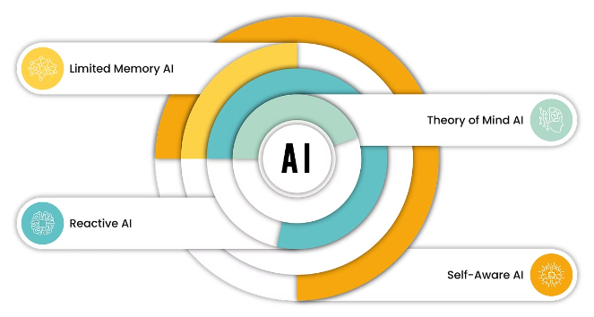
Types of AI Systems
Narrow AI
Narrow AI, also known as "weak AI," is designed to perform a specific task or set of tasks, such as playing chess or recognizing images. These systems excel at their designated tasks but have limited capabilities outside of their specialized domains.
General AI
General AI, or "strong AI," refers to the development of artificial intelligence that can perform a wide range of cognitive tasks, similar to the capabilities of the human mind. This highly advanced and versatile form of AI is still largely theoretical and not yet achieved in practice.
Hybrid AI
Hybrid AI systems combine various AI techniques, such as machine learning, deep learning, and rule-based reasoning, to leverage the strengths of different approaches and tackle more complex problems.
Artificial General Intelligence (AGI)
Artificial General Intelligence (AGI) is the hypothetical ability of an artificial intelligence to match or exceed human capabilities across a wide range of cognitive tasks, including learning, problem-solving, and abstract reasoning.

Slide 10


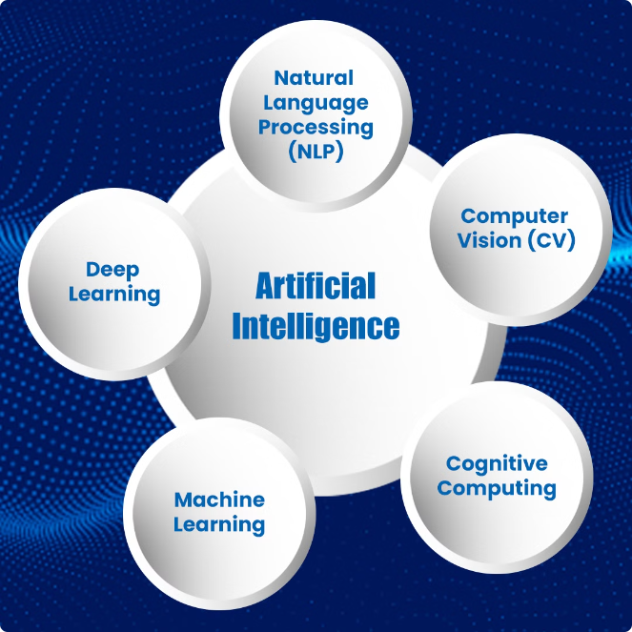



Fields of AI
Computer Vision
Computer vision involves the development of algorithms and systems that can interpret and understand digital images and videos, enabling machines to "see" and analyze the world around them.
Some Links:s:1. This Is What Tesla's Autopilot Sees On The Road (youtube.com), 2. GoodVision Video Insights: Traffic Analysis via Video Extraction (youtube.com)
Natural Language Processing (NLP)
NLP focuses on the interaction between computers and human languages, allowing machines to understand, interpret, and generate natural language, including speech and text.
Example: ChatGPT
Robotics
Robotics combines AI, mechanics, and engineering to create autonomous or semi-autonomous machines that can perform physical tasks, from industrial automation to personal assistance.
Link: Bing Videos, Sophia Awakens - Episode 1 (youtube.com)
Machine Learning
Machine learning is the core of AI, involving the development of algorithms and statistical models that enable computers to learn from data and make predictions or decisions without being explicitly programmed.

Slide 11

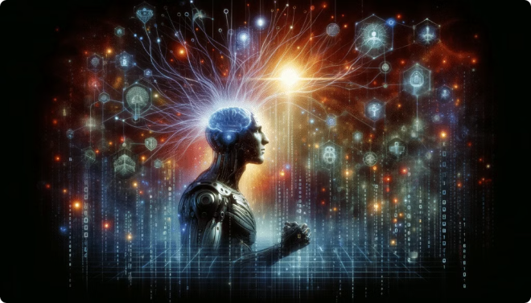
Careers in AI and Big Data Analytics
1
Data Scientist
Data scientists are responsible for collecting, analyzing, and interpreting large, complex datasets to uncover insights and drive data-driven decision-making.
2
Machine Learning Engineer
Machine learning engineers develop and deploy AI-powered systems, focusing on the design, implementation, and optimization of machine learning models and algorithms.
3
AI Architect
AI architects are responsible for designing and overseeing the development of AI-based systems, ensuring they align with an organization's strategic goals and technical requirements.

Slide 12
Supervised vs. Unsupervised Learning
Supervised Learning
Unsupervised Learning
Supervised learning is a type of machine learning where the algorithm is trained on a labeled dataset, meaning the input data is accompanied by the desired output or target variable. The algorithm learns to map the input data to the output, enabling it to make predictions on new, unseen data.
Unsupervised learning is a machine learning technique where the algorithm is trained on unlabeled data, meaning the input data does not have any corresponding output variables. The algorithm's goal is to discover hidden patterns, structures, or groupings within the data without any prior information.
Example: Predicting the price of a house based on features like square footage, number of bedrooms, and location.
Example: Clustering customers into segments based on their purchase behavior and demographic data.

Slide 13


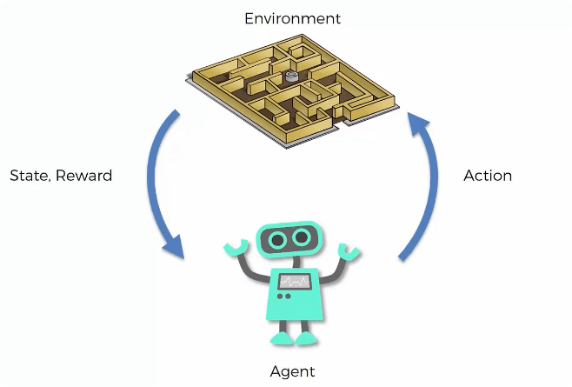



Reinforcement Learning
Observation
The agent observes the current state of the environment.
Action
The agent selects an action to perform based on the observed state.
Reward
The environment provides a reward (or penalty) to the agent based on the chosen action and its impact on the environment.
Learning
The agent uses the received reward to update its knowledge and improve its decision-making for future actions.

Slide 14
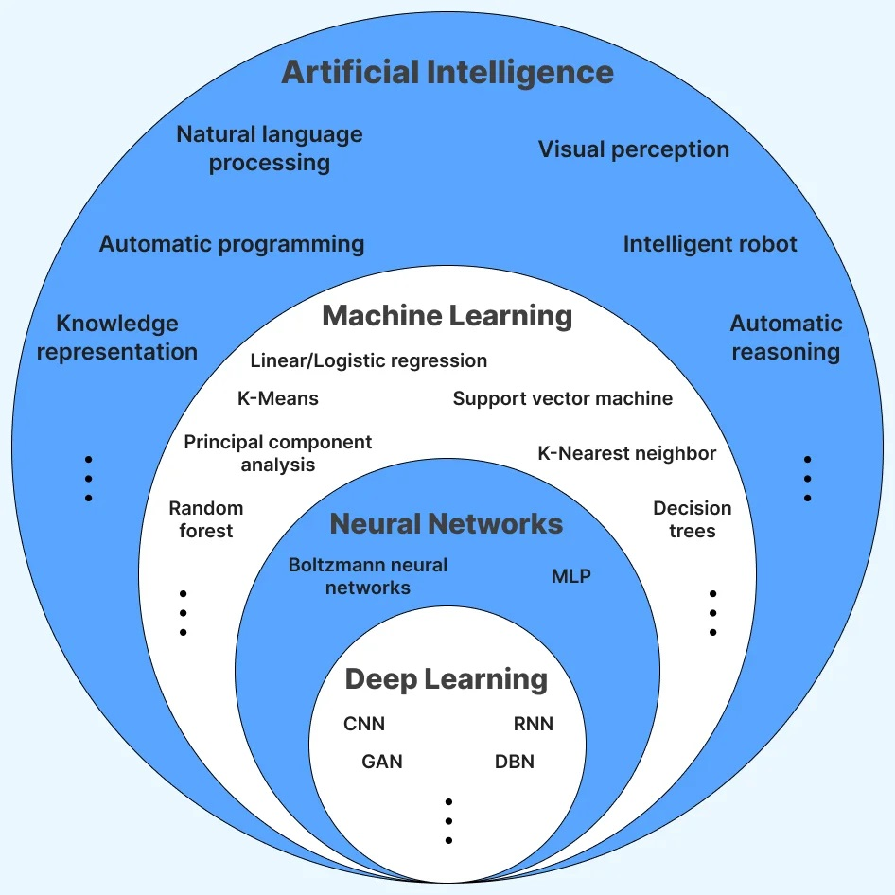
Components of Artificial Intelligence

Slide 15

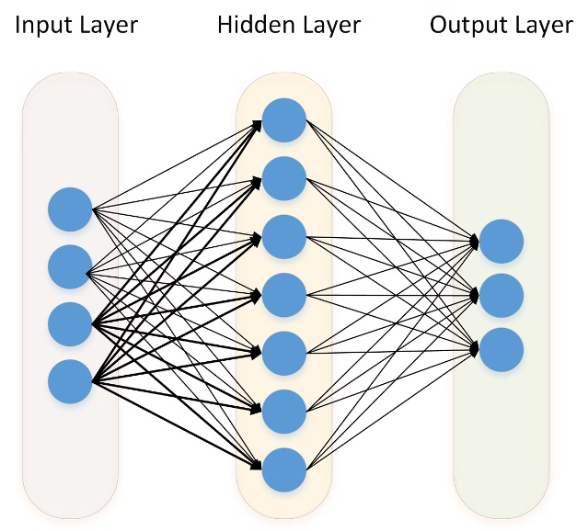
Deep Learning
Shallow Learning
Deep Learning
Limited capacity to learn complex patterns
Ability to learn highly complex patterns and abstractions
Requires manual feature engineering
Learns features automatically from data
Relies on traditional machine learning algorithms
Utilizes artificial neural networks with multiple hidden layers
Suitable for smaller datasets
Excels with large, complex datasets

Slide 16


